Slide 1
HTML Website
By Rob & Audie

Slide 2

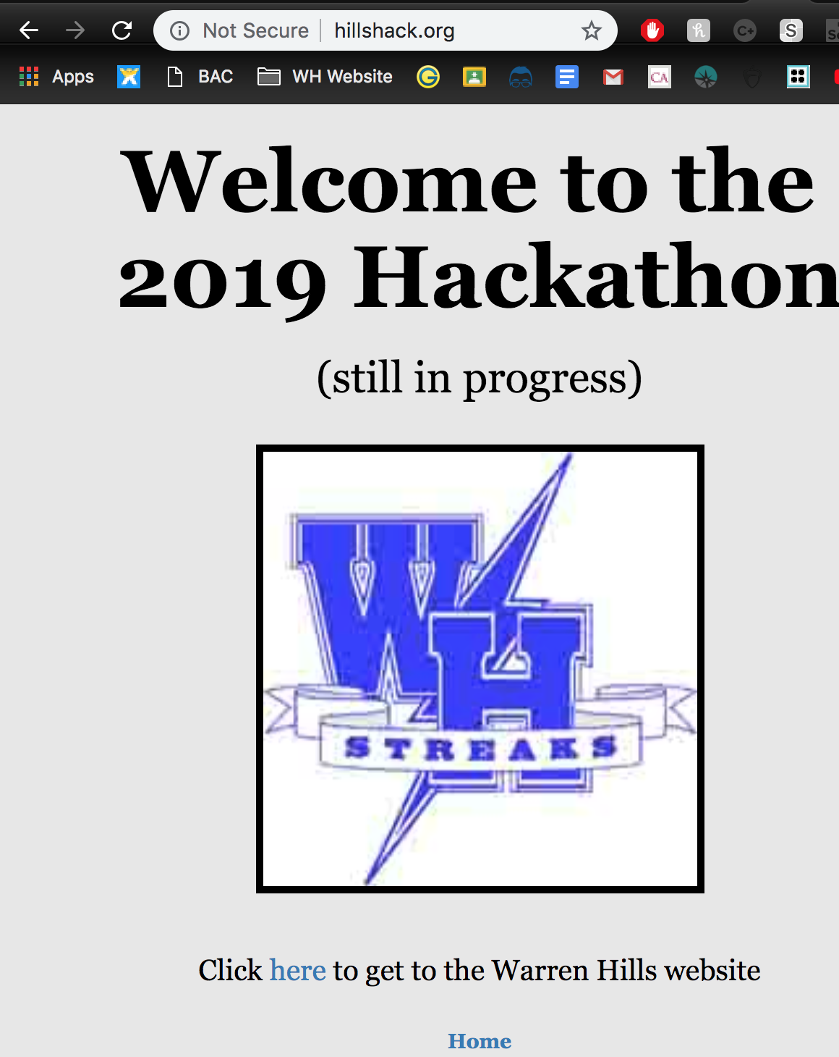
Initial Goals
Learn HTML
Create a functional website
Make the website look nice

Slide 3

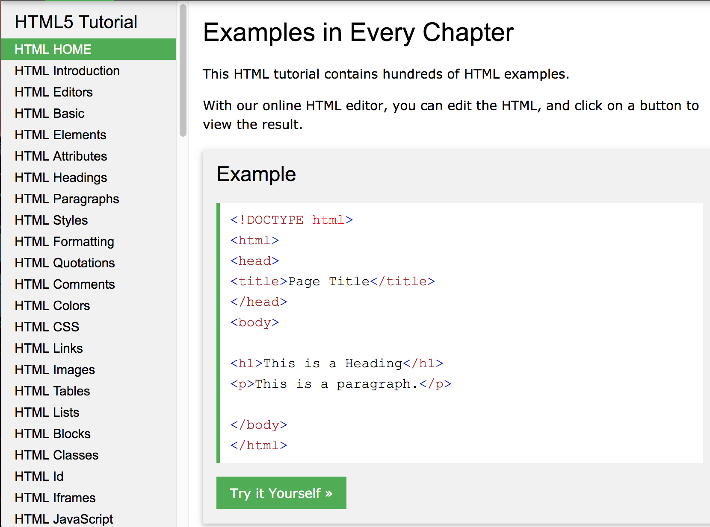
Setting Up
w3schools.com was a massive help
Setting up TextEdit (Mac) and Notepad (hp)
We had to change a bunch of properties
Plain text, Encoding in UTF-8

Slide 4
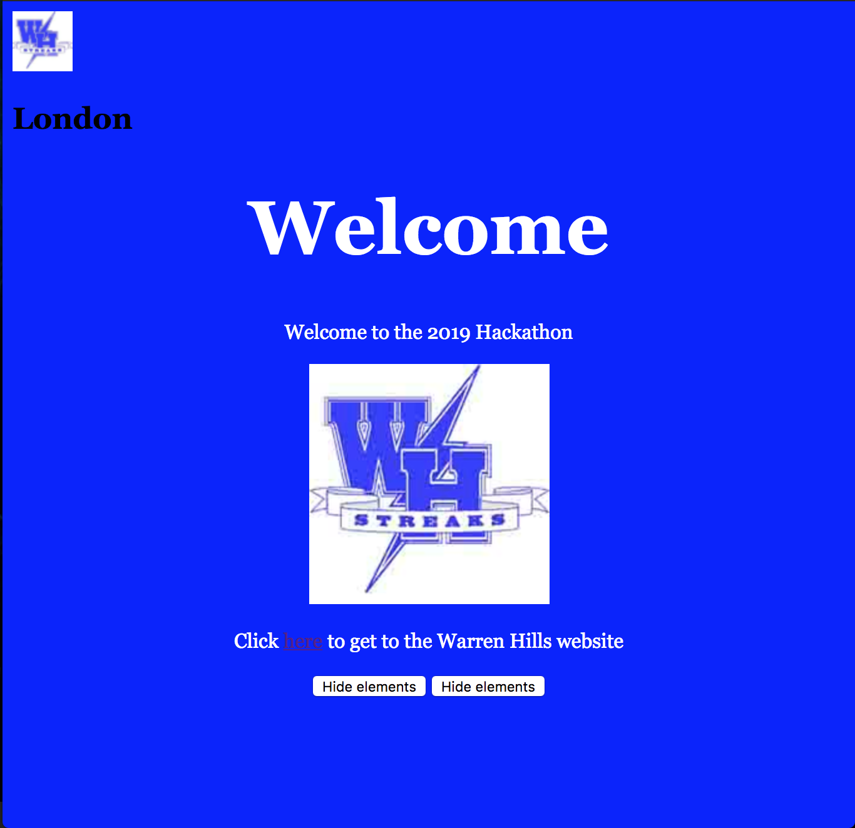
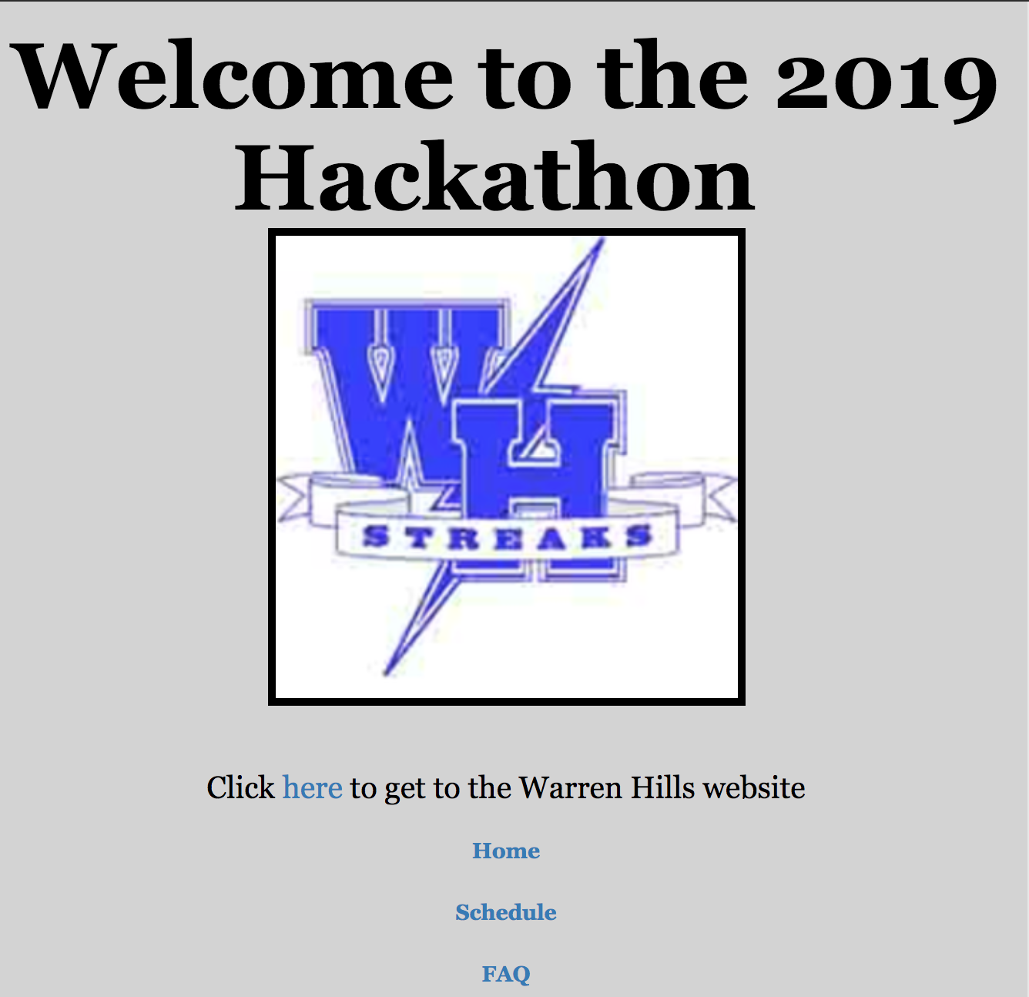
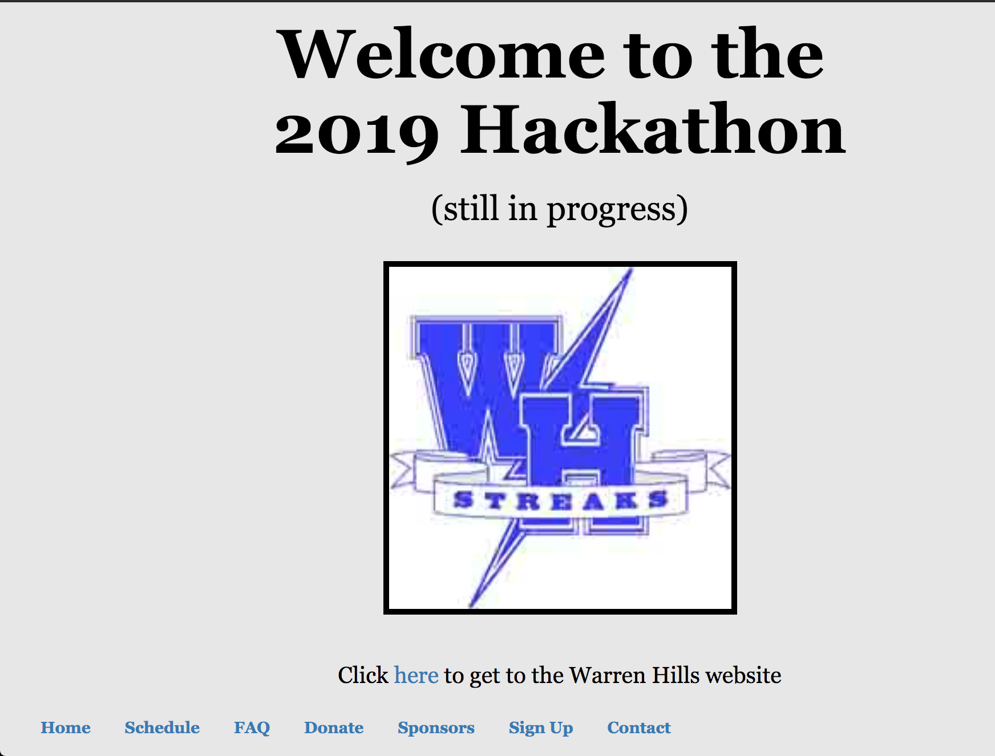
The Process
Following the tutorials
Elements, Styles, Formatting
Slowly building and learning our website

Slide 5
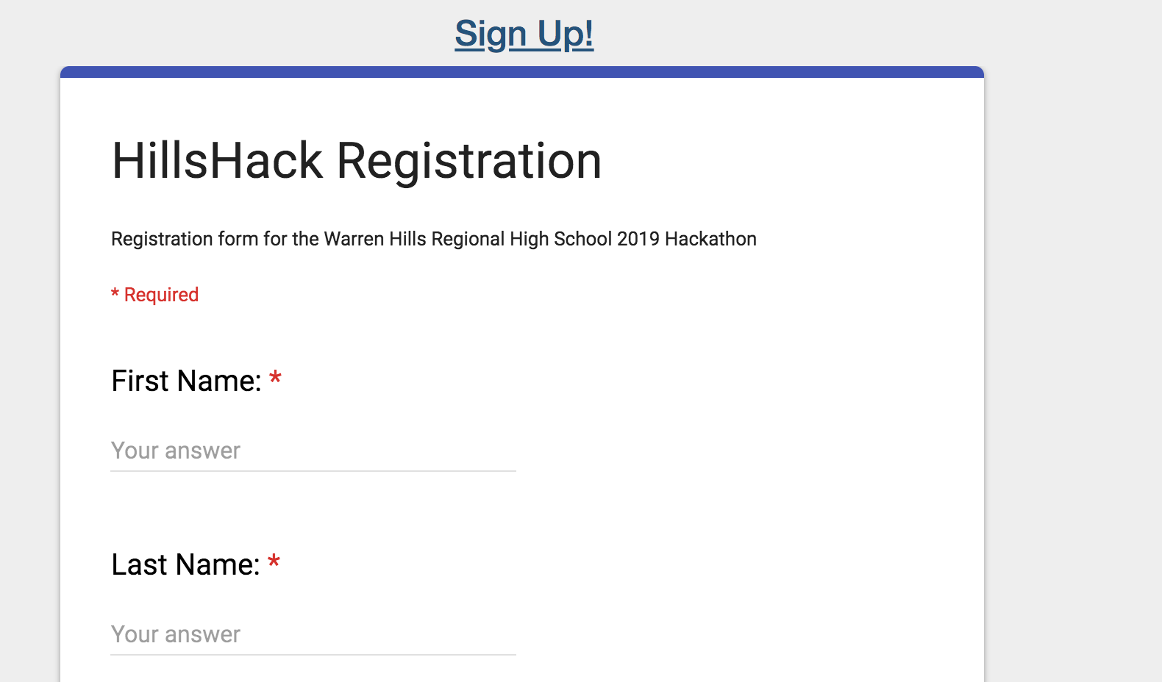
Setbacks
No giant walls, just long muddy paths
Learning HTML as we went meant slower development time
Haven’t yet figured out sending confirmation emails from a submitted Google form
Unfamiliar with CSS (styling sheets)

Slide 6
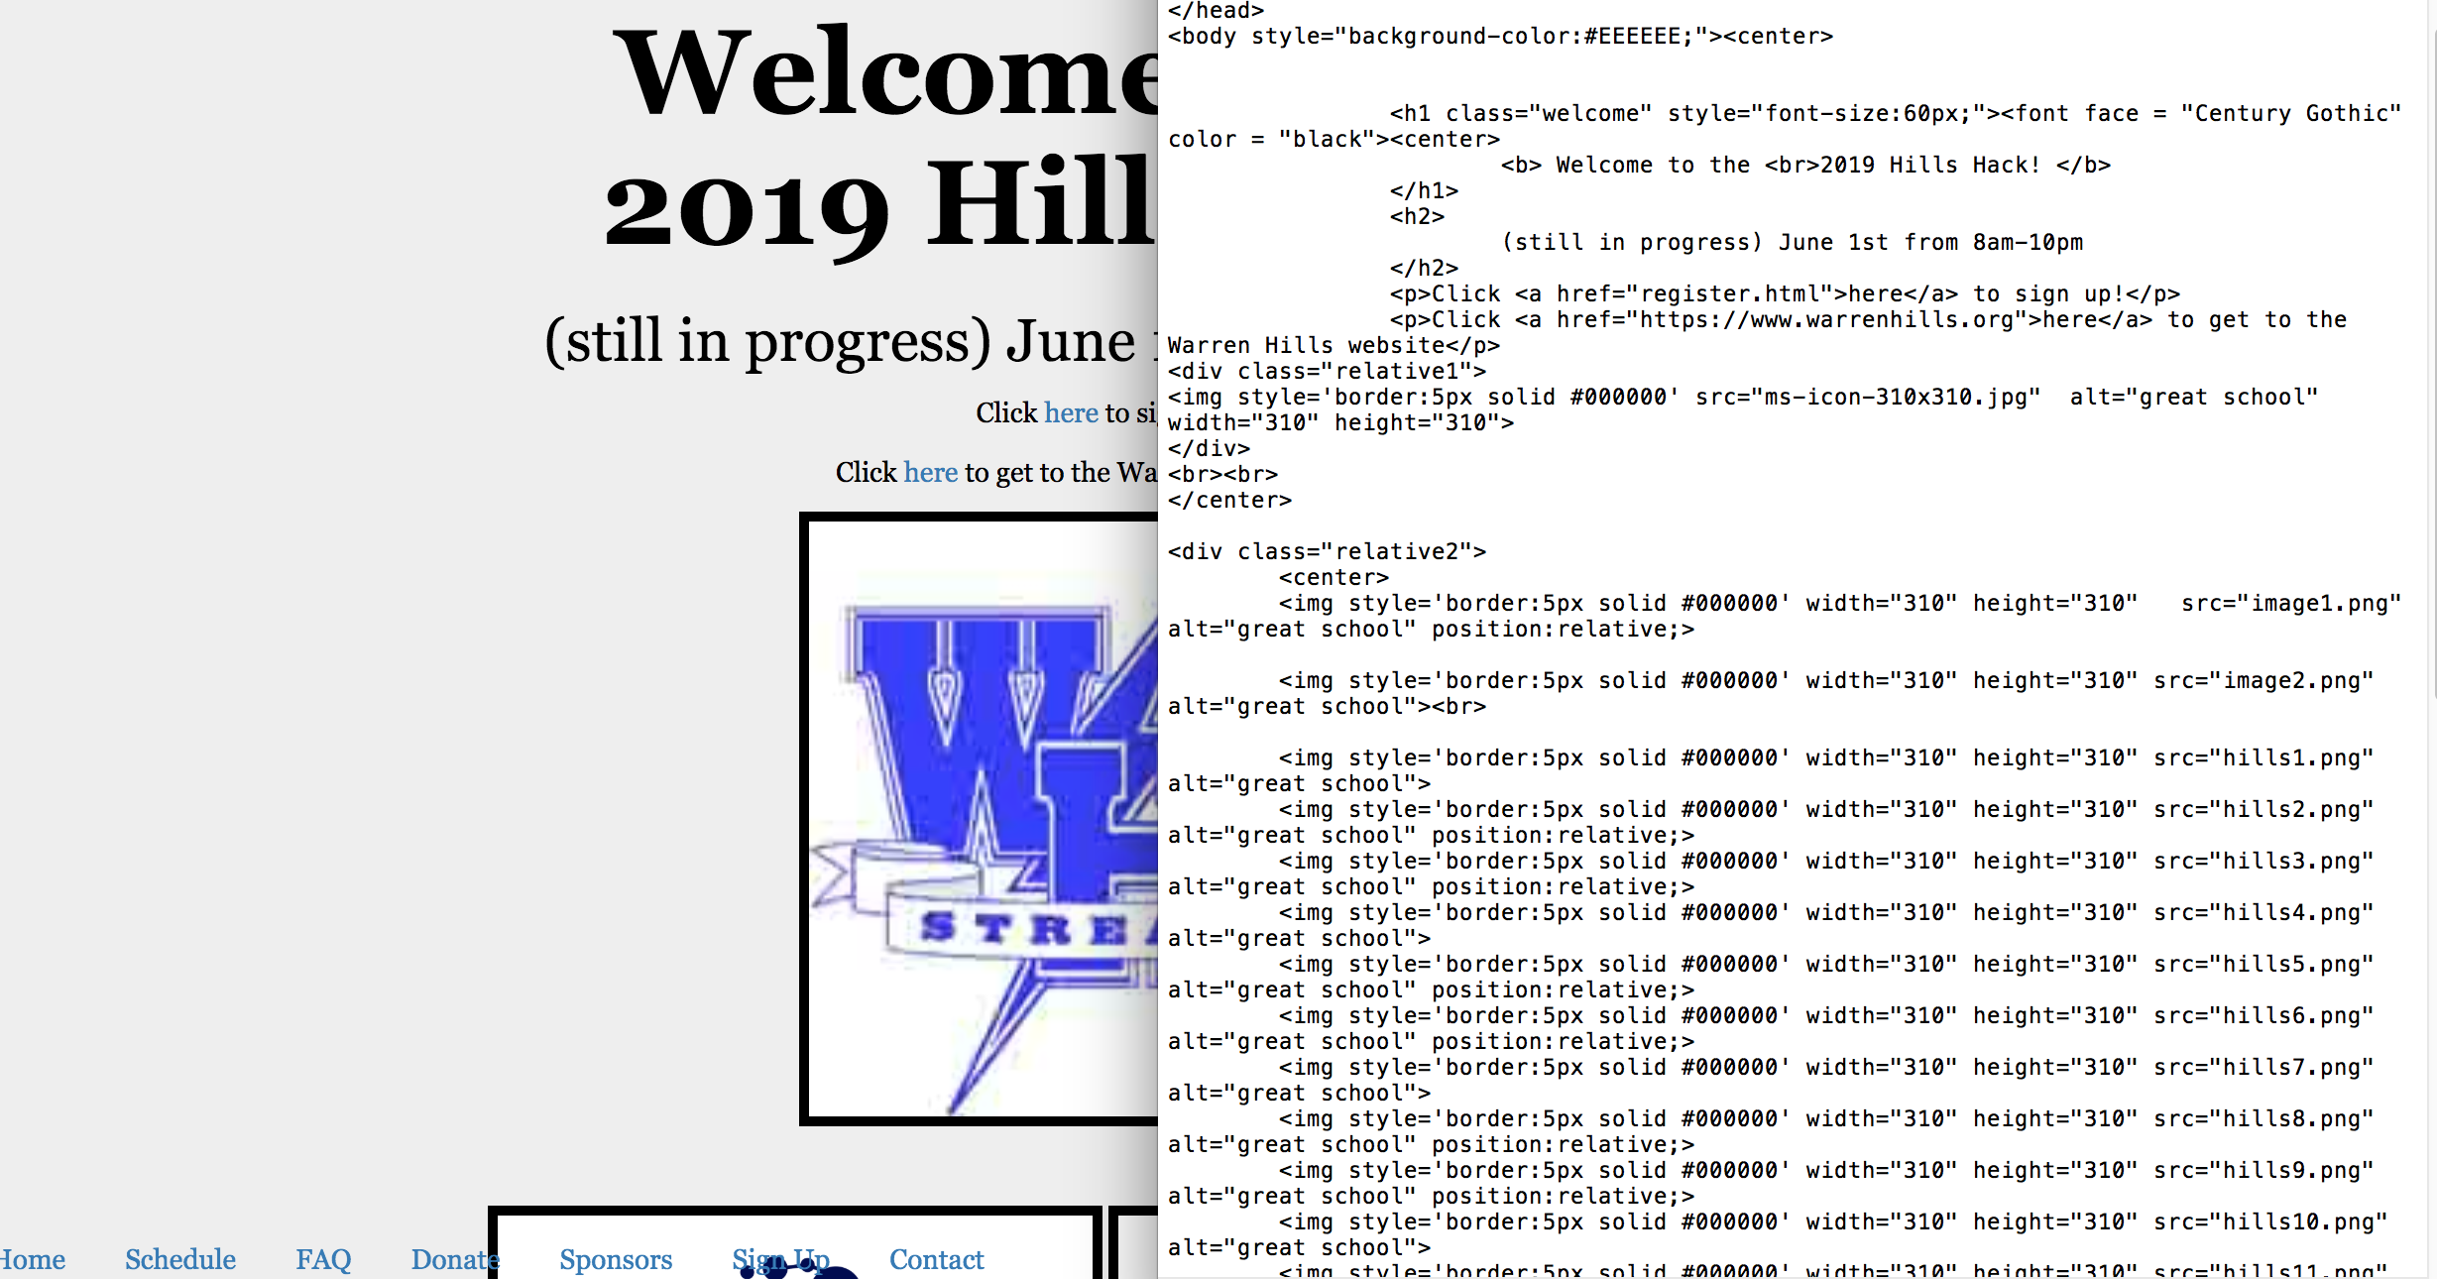
A few files
Bottom half includes lots of pictures
Our Welcome Page
Focused on Mechanics over Artistic Flow (for now)

Slide 7
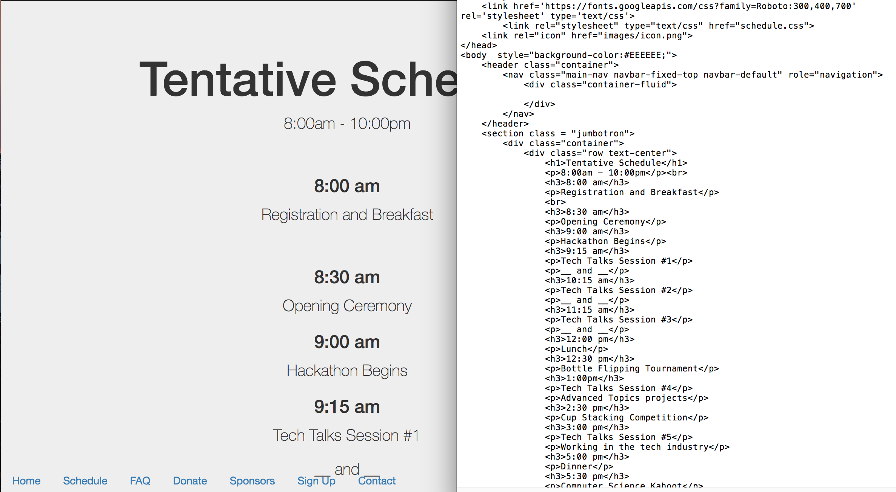
Schedule
Mostly headings
<h3>texthere</h3>
Or paragraphs
<p>texthere</p>

Slide 8
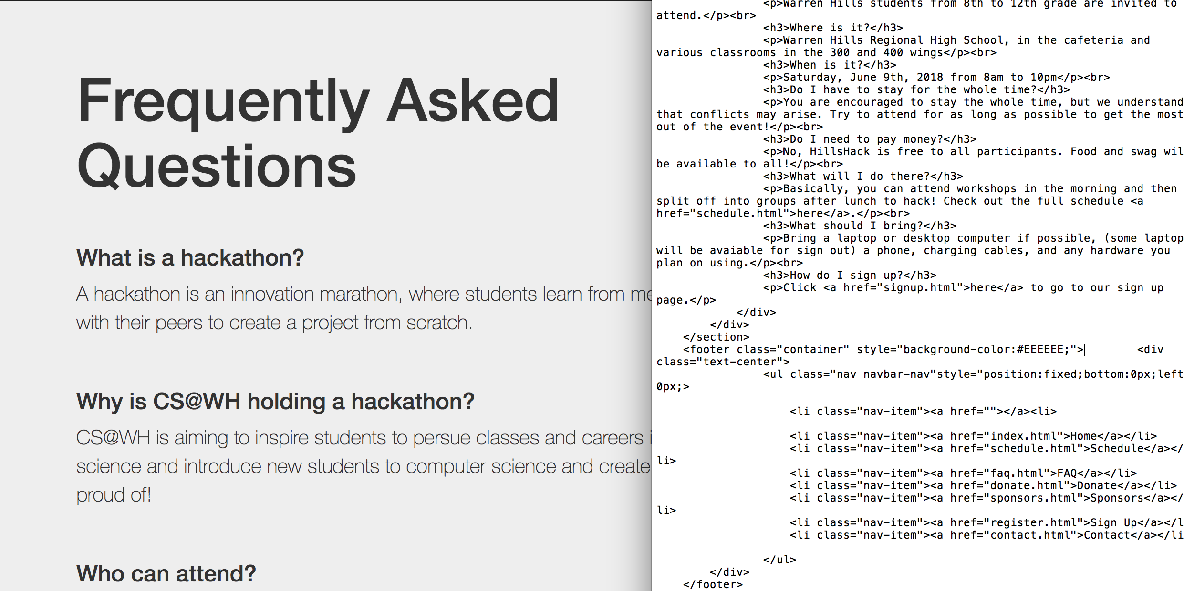
FAQ

Slide 9
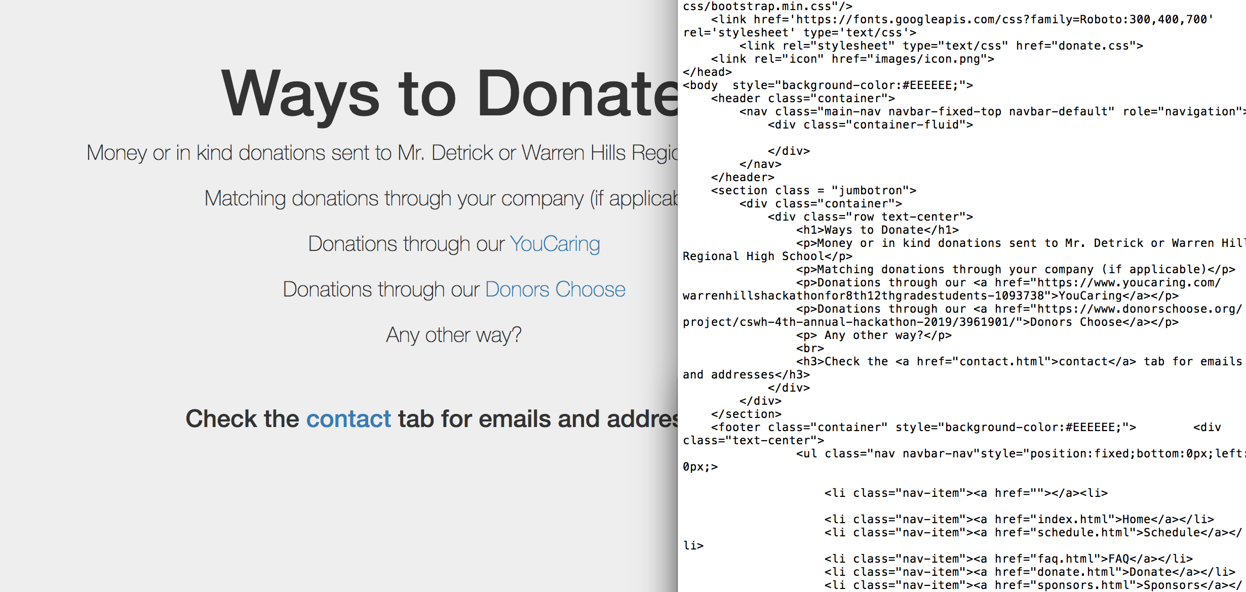
Donating

Slide 10

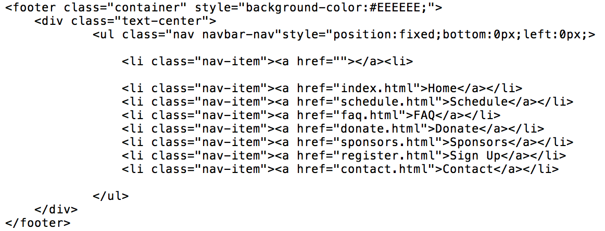
Linking Them Together
The language, ESPECIALLY SYNTAX, is really unfriendly, but tutorials are everything you need
Words like li, ul, and div are really hard to figure out on your own. Easy to get lost in <>’s

Slide 11
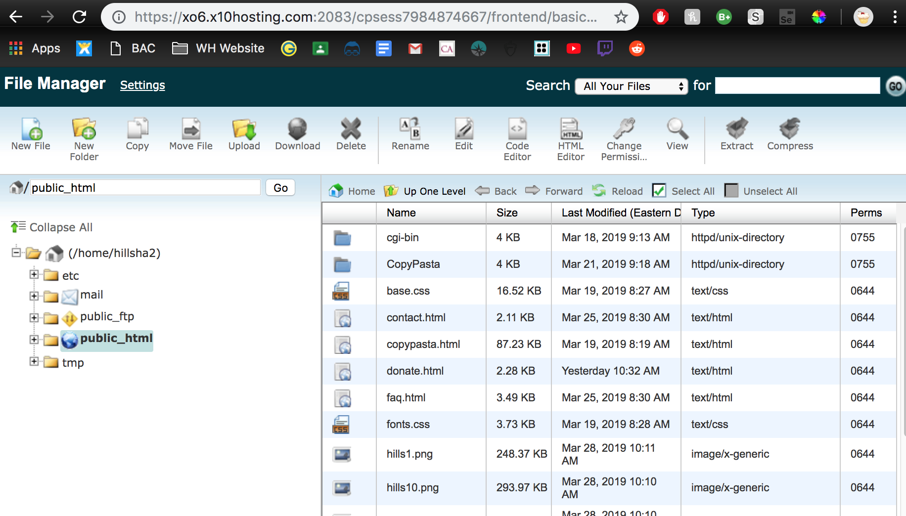
Website Hosting
Simple enough
Hardest part was initially setting up text document

Slide 12
Results
Functional website with working sign up feature
Learned a lot about HTML and integrating JavaScript and CSS into html files
Very arduous, html is not appealing to look at
We don’t regret learning, but it’s an annoying process

Slide 13
hillshack.org
Click here to get to the website!

